Slide 1
EU Budget for the future
Regional development and cohesion
Rudolf Niessler, Director
Athens, 29 June 2018
#CohesionPolicy #EUinmyRegion

Slide 2
  Modernising the policy

Slide 3

Key themes
Modern
Focus on smart, low carbon
Enabling conditions, link to Semester
Simple & flexible
50% shorter regulations
50 key simplifications
Adapts to emerging needs (migration, economy)
For all regions
Objective method
75% for poorest regions
Present for emerging needs elsewhere

Slide 4
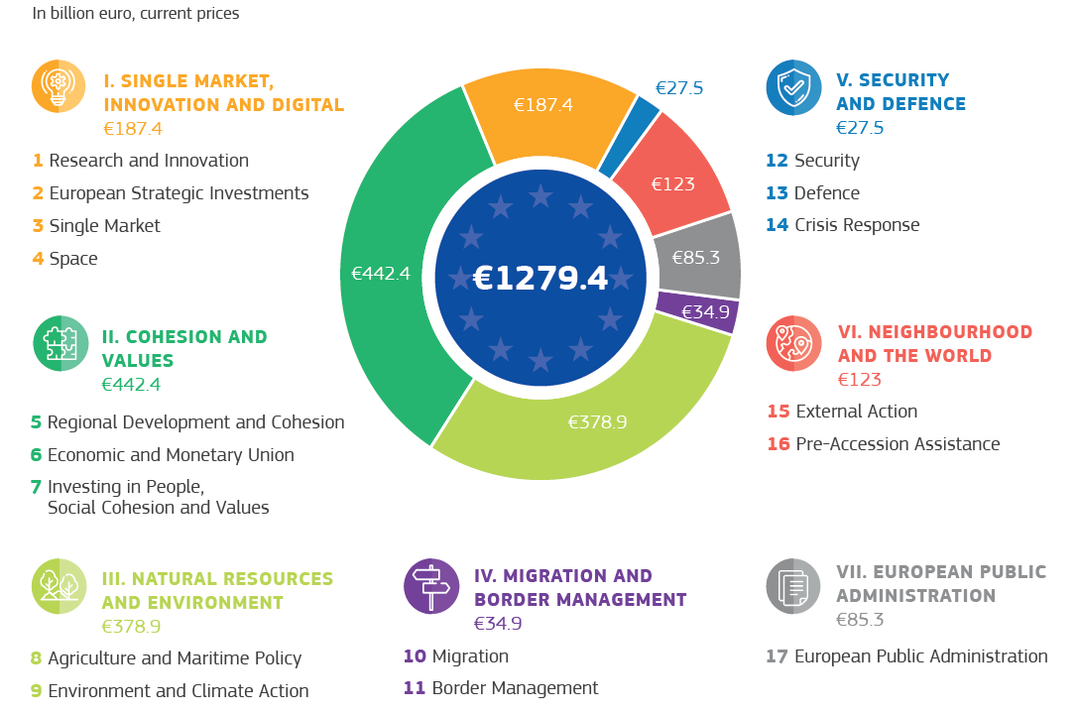
Cohesion Policy within the new MFF

Slide 5
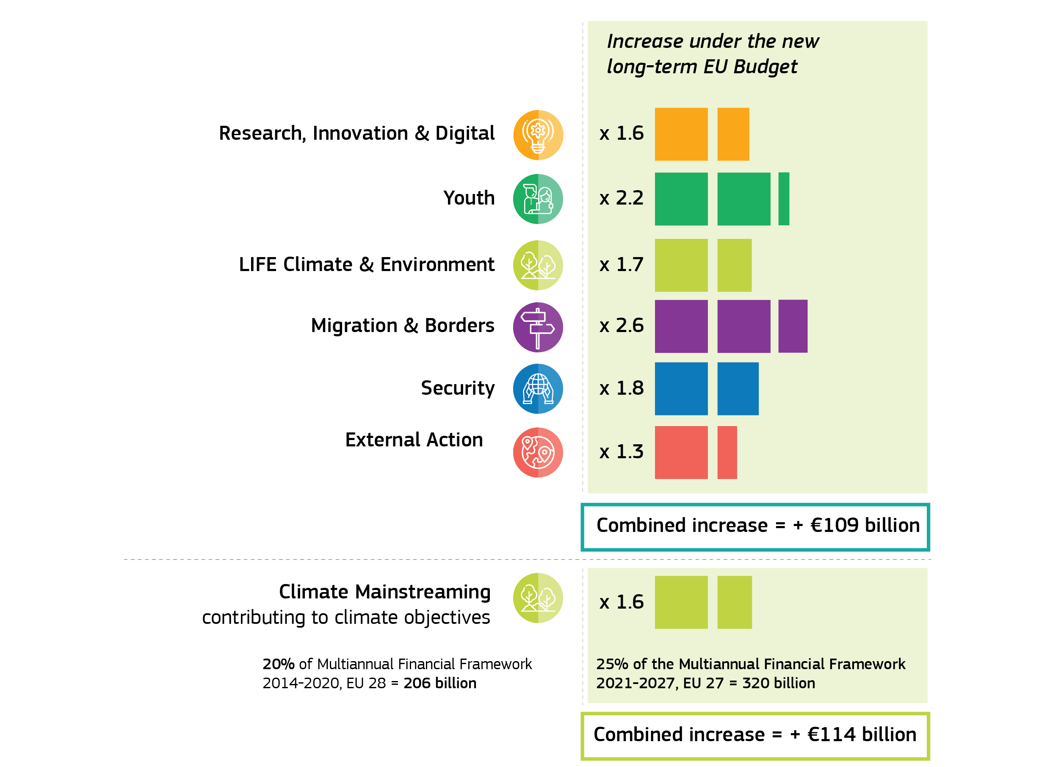
MFF priorities
Note: Compared to MFF 2014-2020 at EU-27 (including European Development Fund)

Slide 6
  Allocations

Slide 7
How are Cohesion Policy allocations set?
The revised 'Berlin method'
 | 2014-2020 | 2021-2027
GDP (incl. GNI for Cohesion Fund) | 86% | 81%
Labour market, education, demographics | 14% | 15%
Climate | - | 1%
Migration | - | 3%
Total | 100% | 100%
Labour market: unemployment rate, youth unemployment rate, employment rate
Education: early school leavers, tertiary level of education, low level of education
Demographics: population of regions, low density of population
Climate: Greenhouse gas emissions in the non-ESD sectors
Migration: Net migration of non-EU citizens
In addition, caps and safety nets apply to 17 MS, among which EL

Slide 8
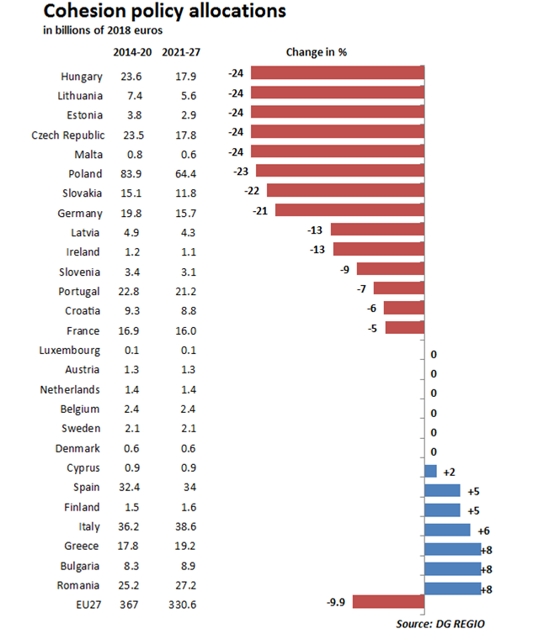

Slide 10
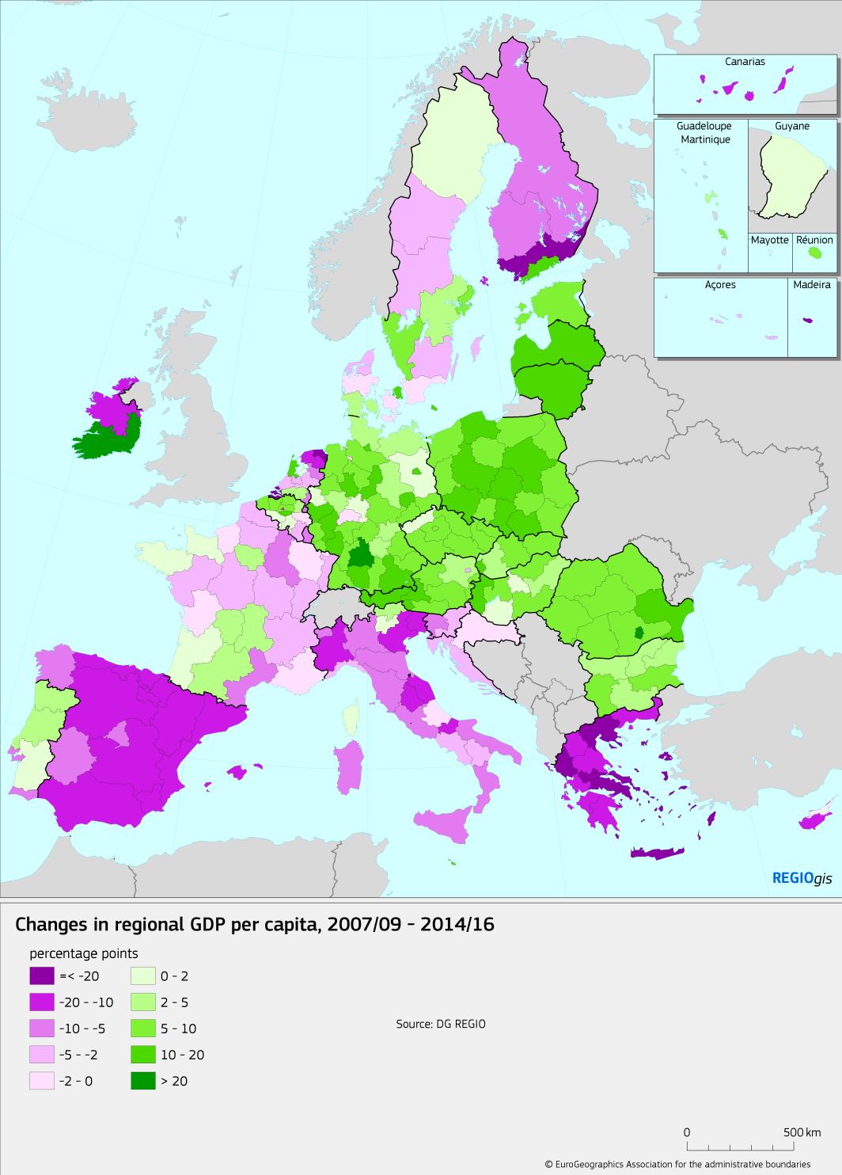
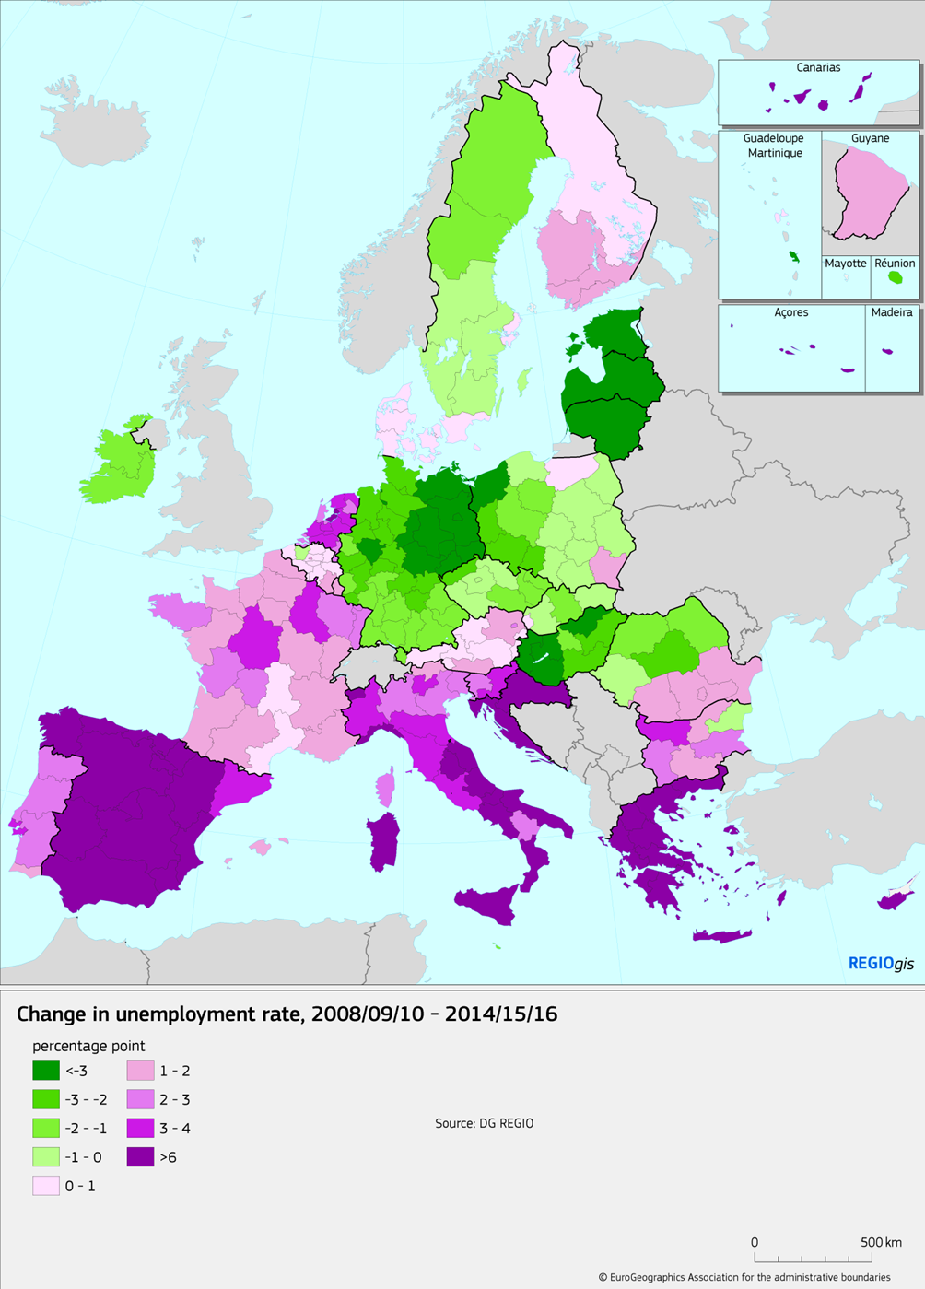

Slide 11
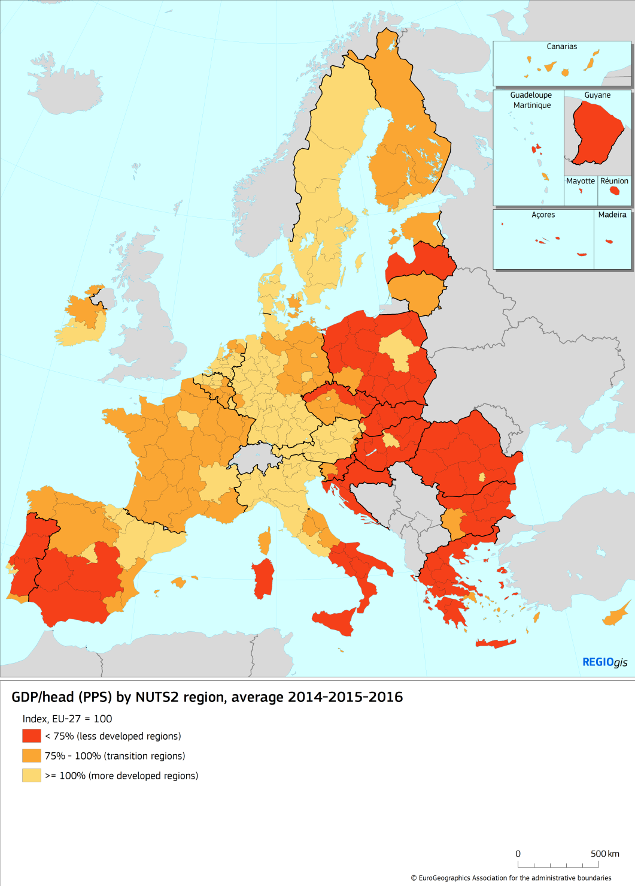
New regional eligibility map
2021-2027

Slide 12
Continued concentration on less developed and transition
 | 2014-2020 | 2021-2027
Cohesion Fund | 22% | 13%
ERDF Less developed regions | 53% | 62%
ERDF Transition | 10% | 14%
ERDF More developed | 15% | 11%
Total | 100% | 100%
Share CF + ERDF less developed | 74% | 75%

Slide 13
  Legal architecture

Slide 14
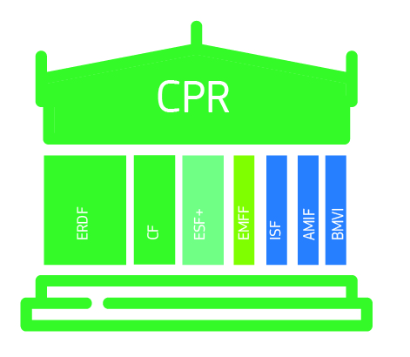
7 funds, 1 regulation
CPR covers delivery. 1 set of rules is:
More coherent
Simpler to learn
Simpler to combine

Slide 15

Coherence with other EU instruments
Key examples:
Horizon Europe ("European excellence")
ERDF ("regional relevance", smart specialisation, innovation diffusion) & reinforced seal of excellence mechanism
CEF/CF: Transfer of EUR 10 billion from the CF to the CEF; trans-European transport networks projects to be financed both through shared and direct management
Migration: all Cohesion Policy Funds will address long-term needs linked to integration, AMIF will focus on short term needs
Reform Support Programme
European Investment Stabilisation Function

Slide 16

Creating the conditions for success
Enabling conditions (used to be "ex ante")
Fewer (35 to 20), clearer, tighter link to policy
Condition for declaration of expenditure
(= no more action plan: instead, conditions followed throughout period)
EU Governance
European Semester
Macroeconomic conditionality
Reform Support Programme
Rule of law

Slide 17
  Next steps

Slide 18
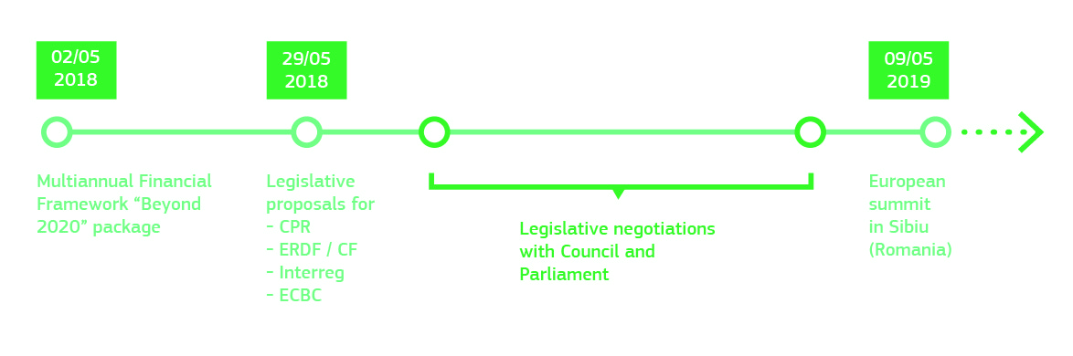
Timeline

Slide 19
Thank you for your attention
#CohesionPolicy #EUinmyRegion

