Slide 1
EU Budget for the future
Regional development and cohesion
Panagiotis Padazatos
Athens, 29 June 2018
#CohesionPolicy #EUinmyRegion

Slide 2
  European Territorial Cooperation

Slide 3
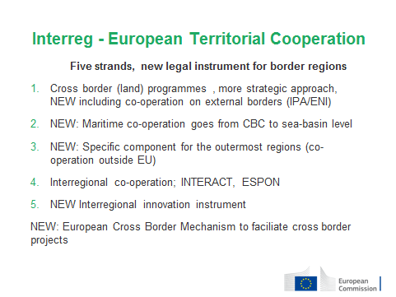

Slide 4
5 + 2 Interreg-specific objectives
A smarter Europe (innovative & smart economic transformation)
A greener, low-carbon Europe (including energy transition, the circular economy, climate adaptation and risk management)
A more connected Europe (mobility and ICT connectivity)
A more social Europe (the European Pillar of Social Rights)
A Europe closer to citizens (sustainable development of urban, rural and coastal areas and local initiatives)
1. A better Interreg governance
2. A safer and more secure Europe

Slide 5
Thematic concentration
 | Percentage | On what?
Components 1, 2 and 3 | At least 60% | Maximum of 3 out of 5
Components 1, 2 and 3 | Another 15% | Better Interreg governance or Safer and more secure Europe
2A Transnational supporting MRS 2B Maritime supporting MRS or SBS Component 4 | 100% At least 70% 100% | Objectives of MRS Objectives of MRS or SBS Better Interreg governance

Slide 6
  Thank you!

